Slide 1

Inventory Management System
By Winifred Dakora

Slide 2

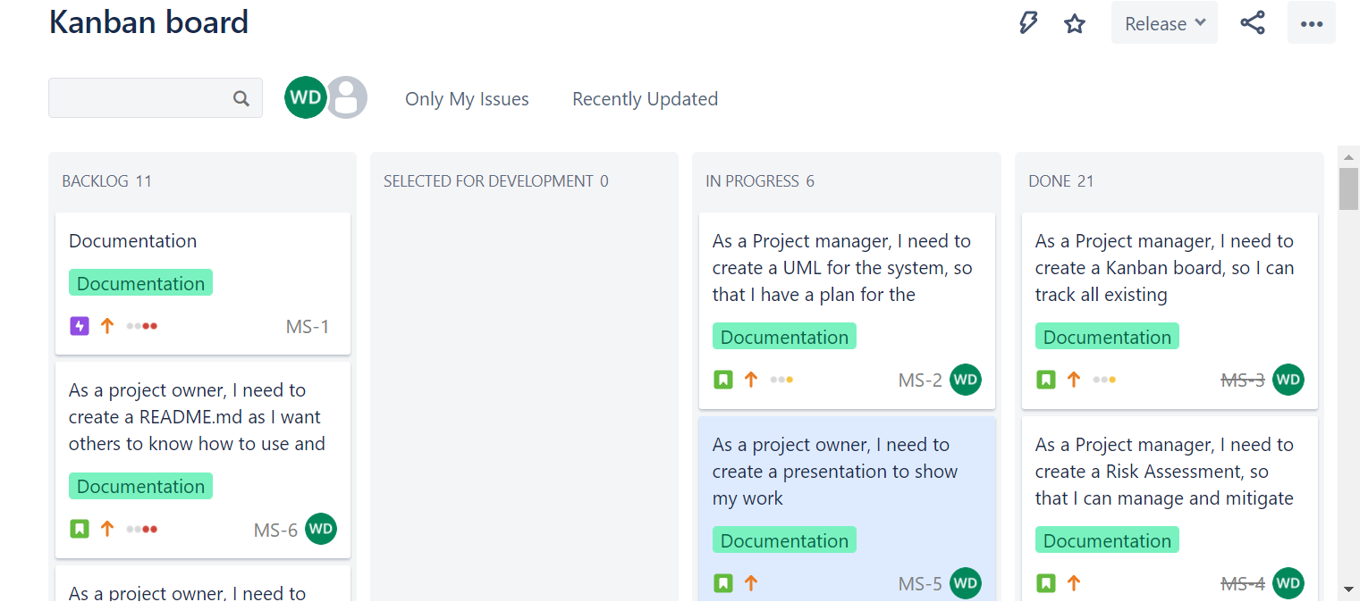
Introduction
Beginner background in the following languages:
Java
SQL
Python
HTML
How I approached the specification:
Kanban board
Drawing diagrams for entity relationships
Link to Kanban board

Slide 3
Consultant journey
Technologies learnt:
Cloud technologies – AWS, GCP, Azure
Git and Github
JDBC
Junit, Maven
Further developed knowledge in:
SQL
Java

Slide 4
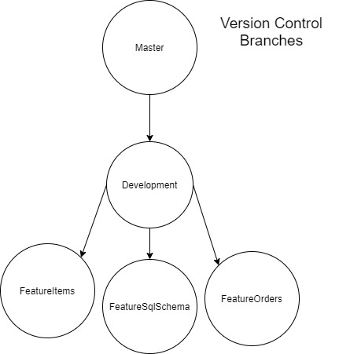
Continuous Integration (CI)
3 feature branches:
FeatureItems
FeatureSQLSchema
FeatureOrders

Slide 5
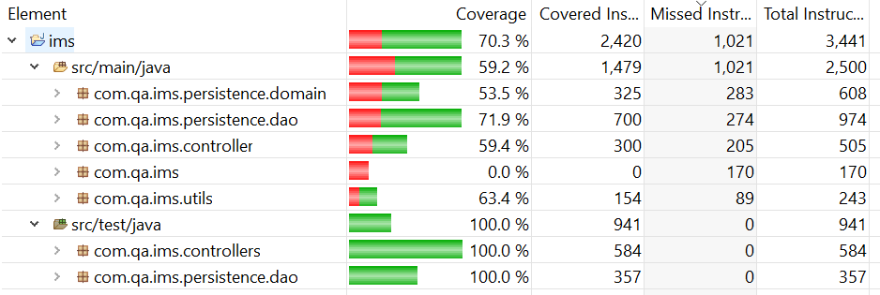
Testing
The following classes were tested:
Customer DAO
Customer Controller
Item DAO
Item Controller
Order DAO
Order Controller

Slide 6

Demonstration
User Stories I will be covering:
Create a customer
Create 3 items
Create an order
Add items to order
Read orders

Slide 7
Sprint review
What was completed:
Full CRUD functionality for the customers page and the items page
Risk assessment
Documentation including presentation
What was left behind:
I was not able to implement an update order or the items within the order
Few test cases
Feature branches for :
Testing
Documentation

Slide 8
Sprint Retrospective
What went well:
Understood the functionality behind creating objects
Documentation and presentation completed
Learned how to used Git
What could be improved:
My knowledge of Java and Junit
Calculating the entire order
Version control
More practice with testing and maven

Slide 9
Conclusion
Improvements to be made with java
A simple function may need a lot more time and effort than originally thought
Planning realistic time scales is very important

Slide 10
Questions?

